Slide 1
Multiple Linear Regression, Model Comparison
Introducing a multiple linear regression model.
Sean Kang

Slide 2
Recap Simple linear regression

Slide 3
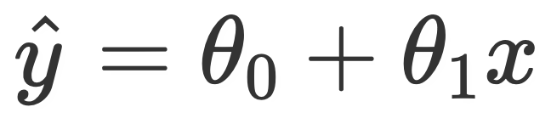
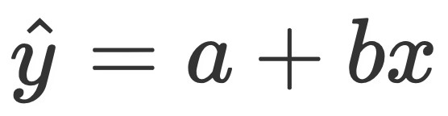
Equation of the SLR line
A simple linear model (with a slope and intercept) is of the form
Note, we have two parameters now. For simplicity’s sake, we will instead say (for now): (lab)
We call this the simple linear regression model.
Notes:
Look at slope and intercept function in lab

Slide 4
How do we know our fit? RMSE and R²

Slide 5
Evaluating models
What are some ways to determine if our model was a good fit to our data?
Look at MSE or RMSE or R²
When our MSE or RMSE is very close to zero, and when R2 is closer to 1
These are metrics to measure the fitness of our model
Notes:
This is new terminology.

Slide 6
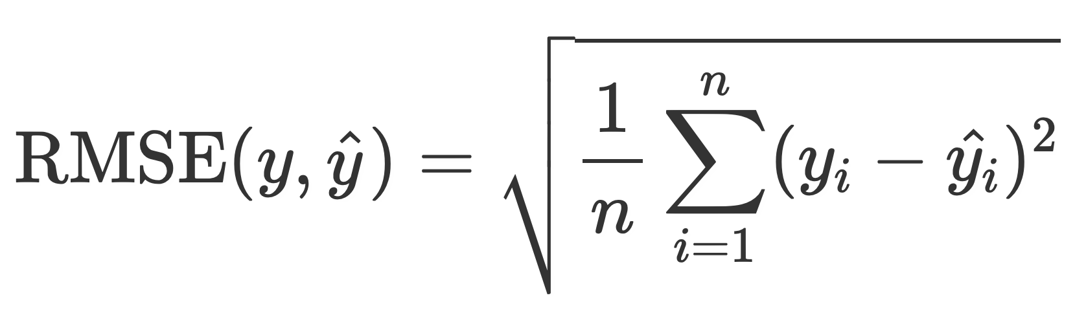
Root Mean Squared Error (RMSE)
Root mean squared error is defined as being the square root of the mean squared difference between predictions and their true values.
It is the square root of MSE, which is the average loss that we’ve been minimizing to determine optimal model parameters.
RMSE is in the same units as y.
A lower RMSE indicates more “accurate” predictions.
Lower average loss across the dataset.
Does not penalize as much as MSE due to square root

Slide 7
R SQUARE – R²
It is a measurement of how good model is.
It measures the relationship between the model and the dependent variables
AKA
Coefficient of determination
Coefficient of multiple determination (for multiple regression)

Slide 8
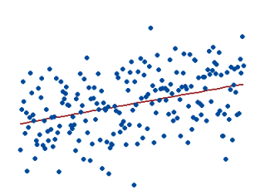
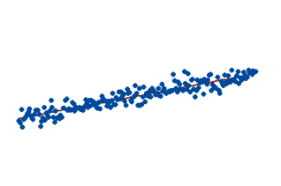
Interpreting the Values of R Square
1 – Perfect Fit – suspicious
~ 0.9 – Very good
< 0.7 – Not Great
<0.4 – Terrible
<0 Model makes no sense
0.15
0.85

Slide 9
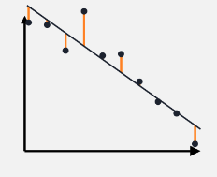
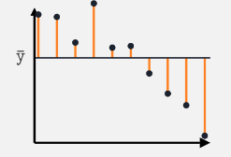
Y – hat versus Y- average

Slide 10

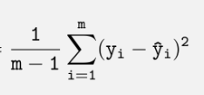

How to Calculate R Square
Unexplained Variance
Total Variance

Slide 11
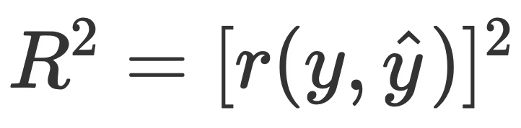
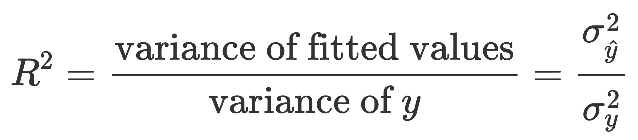
Another way to calculate R²
We define the R² value as the square of the correlation between the true y and predicted y. This is also referred to as the coefficient of determination.
Since it is the square of a correlation coefficient (which ranged between -1 and 1), R² ranges between 0 and 1. Another way of expressing R², in linear models that have an intercept term, is
Thus, we can interpret R² as the proportion of variance in our true y that our fitted values (predictions) capture, or “the proportion of variance that the model explains.”

Slide 12
R²
As we add more features, our fitted values tend to become closer and closer to our actual y values. Thus, R² increases.
The simple model (AST only) explains 45.7% of the variance in the true y.
The AST & 3PA model explains 60.9%.
Adding more features doesn’t always mean our model is better, though!
R² = 0.457
R² = 0.609

Slide 13
Multiple linear regression
MLR is an extension of Simple Linear Regression.

Slide 14
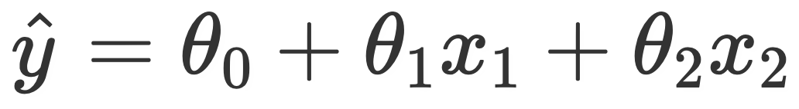
Adding independent variables
Estimated multiple regression model with two features (and thus, three parameters), is of the form

Slide 15
Adding More Independent Variables
Adding more variables does not always mean a better fitting model.
Does not always make predictions better
More variables can explain more variations
The best way:
Pick the best input variables for the model
Problems:
Overfitting – add variance, or can explain for variation in output but does not add much prediction to the model.
Multicollinearity – independent variables are dependent on each other, not just the output variable

Slide 16
Idea Example
Bad Example
Housing Price – the output dependent variable
Input Independent Variables
Age of house
Square foot space of the house
Ratings of the high school
Great view from backyard
Interior Renovations
Housing Price – the output dependent variable
Input Independent Variables
Num of bed and bath
Square foot space of the house
Master bedroom on main floor

Slide 17
Prep Work
Correlations
Scatter Plots
Simple Regressions

Slide 18
Let’s Start
Dependent Variable: Housing Price (Estimated)
Independent Variable:
Square Foot of the living space
Ratings of the High School
Sq Ft
(x₁)
Price
School Rating (x2)

Slide 19
If you add more variables
The number of potential collinearity relationships between the independent variables exists and must be analyzed.
Some independent variables are better than others
Some have no contribution to the dependent variable

Slide 20
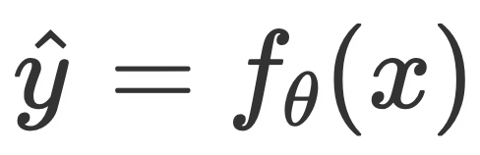
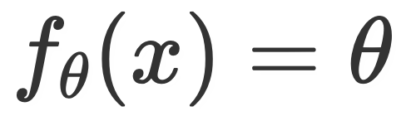
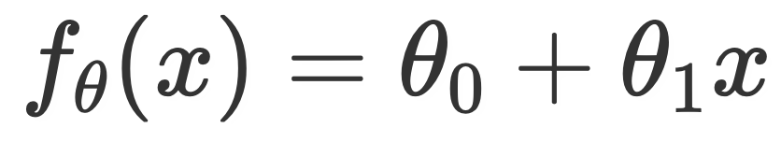

General notation
Our models can be expressed as a function of an input variable, x.
Constant model:
Simple linear regression model:
Multiple linear regression model:
Intercept
Variables
Coefficients

Slide 21
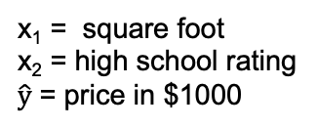
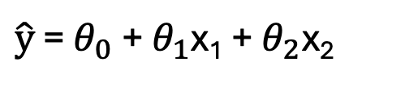
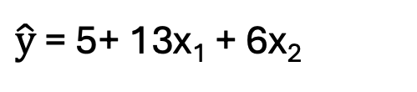
Interpretation
$\hat{\text{y}}$ = $θ_{0}$ + $θ_{1}$x₁ + $θ_{2}$x₂
x₁ = square foot
x₂ = high school rating
$\hat{\text{y}}$ = price in $1000
$\hat{\text{y}}$ = 5+ 13x₁ + 6x₂
1 square foot of space would translate to 13k towards the price of the house, keeping the school rating constant.
If the high school rating is an ordinal from 1-10 where 10 is the best and 1 is the lowest, a school rating of 1 would only contribute 6k towards the price of the house.

Slide 22
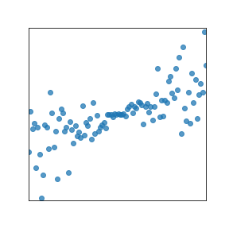
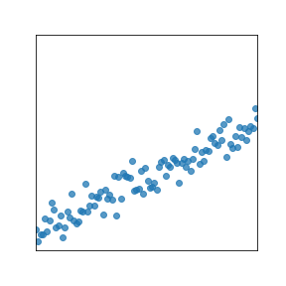
Some Scatter Plots of IV to DV
Price
Price
School Rating
Square Foot
Both square footage and school ratings have a highly correlated to Price.

Slide 23
Some Scatter Plots of IV to IV
Square Foot
School Rating
These two IV have a visual correlation relationship. We will just note that for now. We can calculate the actual correlation coefficient in the lab.

Slide 24
Summary

Slide 25
Summary
We now know of three models, .
The constant model, .
The simple linear regression model .
The multiple linear regression model ..
We looked at the correlation coefficient, r, and studied its properties.
We solved for the optimal parameters for the simple linear model by hand, by minimizing average squared loss (MSE) or algebra in prior lecture.
We introduced the notion of a feature, and how we can have multiple in our models.
We discussed the R² coefficient and RMSE as methods of evaluating the quality of a linear model.

